Slide 1




MBC 638: Data Analysis & Decision Making
Anna Chernobai
Lecture 13 (Part 3):
Hypothesis testing; application to regression (Chapters 10, 11)

Slide 2
Today: Hypothesis testing
Hypothesis testing for regression coefficients

Slide 3
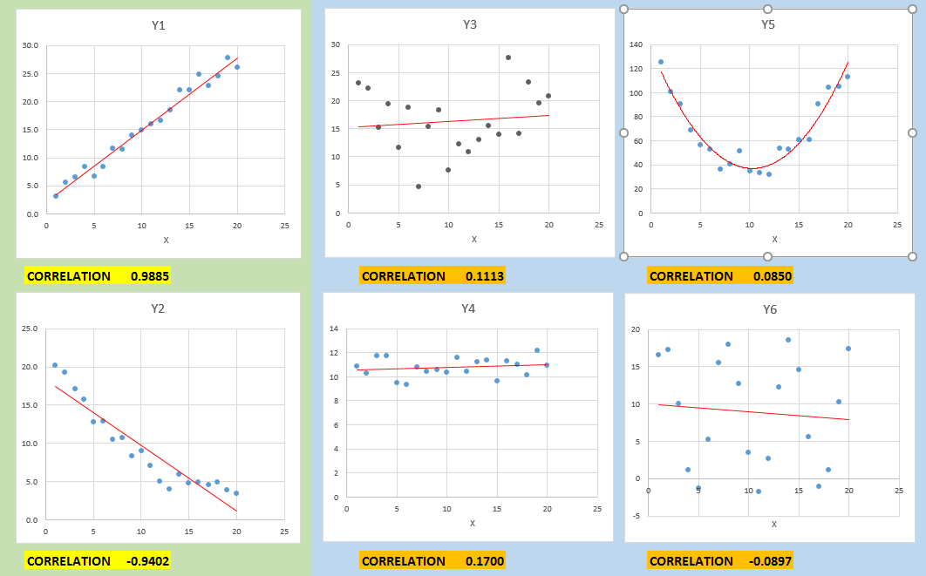
Recall: Examples of no linear relationship
Quadratic
(but not linear)
positive
negative

Slide 4
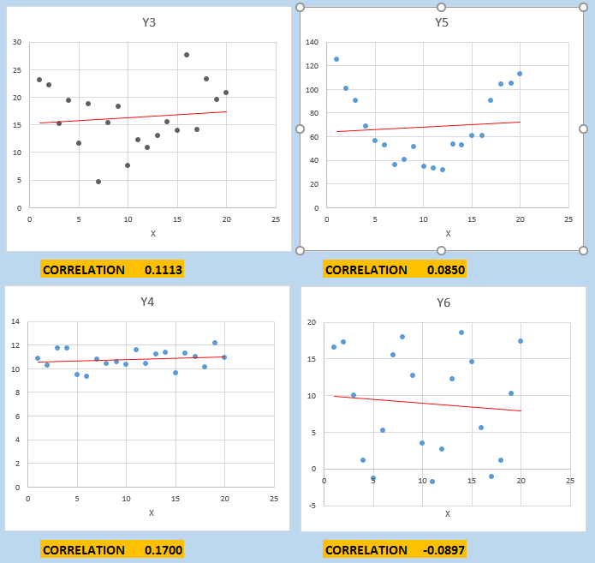
1. Examples of no linear relationship
○ What do these examples have in common?
The linear regression line has slope ≈ 0.
Quadratic
(not linear)
○ What does this mean?
Slope = 0 means that X does not explain Y (in a linear way).
Slope ≠ 0 means that X explains Y well (in a linear way).
Therefore, to show that X explains Y well (in a linear way), we need to show that the slope ≠ 0.

Slide 5
Hypothesis testing for regression coefficients
We want to know whether X significantly affects Y.
Recall: If X is linearly associated with Y, then the slope is not zero.
y
ŷ = b₀ + b₁ x
b₁=slope
b₀
x

Slide 6
Hypothesis testing for regression coefficients
We want to know whether X significantly affects Y.
Recall: If X is linearly associated with Y, then the slope is not zero.
Estimated coefficients from the sample
y
ŷ = b₀ + b₁ x
b₁=slope
b₀
x

Slide 7
Hypothesis testing for regression coefficients
We want to know whether X significantly affects Y.
Recall: If X is linearly associated with Y, then the slope is not zero.
Estimated coefficients from the sample
y
ŷ = b₀ + b₁ x
b₁=slope
b₀
x
2-tailed test:
H₀: β₁ = 0 (X is not a good linear predictor of Y)
H_{A}: β₁ ≠ 0 (X is a good linear predictor of Y)
True slope coefficient from the population

Slide 8
Hypothesis testing for regression coefficients
How does the test work?

Slide 9
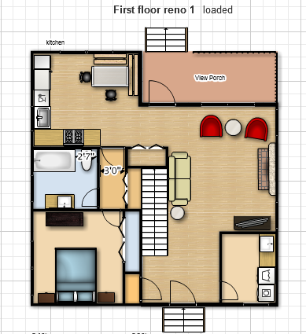
Example
X = square footage Y = selling price of house
r = 0.749
Simple regression:
ŷ = 50527 + 46.991x R² = 0.5618
These coefficients were obtained from one sample of 150 homes

Slide 10
Population of square footages of ALL homes
Population of prices of ALL homes

Slide 11
Population of square footages of ALL homes
Population of prices of ALL homes
Ŷ = 50,000 + 50 * X

Slide 12
Population of square footages of ALL homes
TRUE INTERCEPT (β0)
TRUE SLOPE (β1)
Population of prices of ALL homes
Ŷ = β0 + β1 * X
Ŷ = 50,000 + 50 * X

Slide 13
Let’s pick a sample from this population…

Slide 14
Population of square footages of ALL homes
Population of prices of ALL homes
Ŷ = β0 + β1 * X
Ŷ = 50,000 + 50 * X
Boyce’s sample:
Ŷ = 45,500 + 49 * X
(b0) (b1)

Slide 15
What if we pick a different sample…
Would the b0 and b1 coefficients remain the same?

Slide 16
Population of square footages of ALL homes
Population of prices of ALL homes
Ŷ = β0 + β1 * X
Ŷ = 50,000 + 50 * X
Laura’s sample:
Ŷ = 52,800 + 25 * X
(b0) (b1)

Slide 17
Population of square footages of ALL homes
Population of prices of ALL homes
Ŷ = β0 + β1 * X
Ŷ = 50,000 + 50 * X
Ben’s sample:
Ŷ = 72,300 - 13 * X
(b0) (b1)

Slide 18
○ What’s the idea here?
POPULATION Ŷ = β0 + β1 * X Ŷ = 50,000 + 50 * X True (population) coefficients.
They are unknown to us.
SAMPLE 1 Ŷ = b0 + b1 * X Ŷ = 45,500 + 49 * X
SAMPLE 2 Ŷ = b0 + b1 * X Ŷ = 52,800 + 25 * X
SAMPLE 3 Ŷ = b0 + b1 * X Ŷ = 72,300 ─ 13 * X
Other samples … …
Depending on the sample, coefficients are different.
These are estimated coefficients (from small samples), not population coefficients.
In some cases b1 may be <0.
Overall, do we have evidence that the population slope (β1) ≠ 0 ?

Slide 19
Hypothesis testing for regression coefficients
We want to know whether X significantly affects Y.
Recall: If X is linearly associated with Y, then the slope is not zero.
Estimated coefficients from the sample
y
ŷ = b₀ + b₁ x
b₁=slope
b₀
x
2-tailed test:
H₀: β₁ = 0 (X is not a good linear predictor of Y)
H_{A}: β₁ ≠ 0 (X is a good linear predictor of Y)
True slope coefficient from the population

Slide 20
Hypothesis testing for regression coefficients
2-tailed test for the slope coefficient:
This tests help us answer the following questions:
“Is there a linear relationship between X and Y?”
“Does X help linearly explain Y?”
“Is X a good linear predictor of Y?”
ŷ = b₀ + b₁ x
H₀: β₁ = 0 (X is not a good linear predictor of Y)
H_{A}: β₁ ≠ 0 (X is a good linear predictor of Y)
b₁=slope
x

Slide 21
Hypothesis testing for regression coefficients
2-tailed test for the slope coefficient:
As a result of this test, we obtain p-value.
Decision rule: Reject Ho if p-value < α (α is predetermined, e.g., 0.05)
What would it mean if p-value < α? Yes, we have sample evidence that X is a good linear predictor of Y (or, that yes, there is a linear relationship between X and Y).
What would it mean if p-value > α? No, we don’t have evidence that X is a good linear predictor of Y (or, we have no evidence of a linear relationship between X and Y).
H₀: β₁ = 0 (X is not a good linear predictor of Y)
H_{A}: β₁ ≠ 0 (X is a good linear predictor of Y)
Null hypothesis
Alternative hypothesis

Slide 22
Hypothesis testing for regression coefficients
Let’s look at our past example.

Slide 23
Hypothesis testing for regression coefficients
Recall Lecture 05 (OLS regression).
Example
Housing prices. See Excel file Housing Data 148.xlsx
Y = Selling prices
X₁ = Square footage
X₂ = Number of bedrooms
X₃ = Number of baths

Slide 24
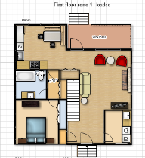


Hypothesis testing for regression coefficients
Regression equation for home selling price is:
Predicted selling price ($) = 50,024
 47.6 * Square Feet
― 136.5 * Num Bedrooms
― 75.8 * Num Bathrooms

Slide 25
Hypothesis testing for regression coefficients
Multiple regression:

Slide 26
Hypothesis testing for regression coefficients
Multiple regression:
Which of the 3 explanatory variables are good linear predictors of selling price?
Notes:
1, square foot is the only good linear predictor of selling price because the p-value is low, which means statistically significant that its b affects dependent variable.

